Slide 1
CENTRE OF POLYMER SYSTEMS

Slide 2
CONTENT
9:00 – 10:00 am
Course focused on the acquisition and acceptance of the basic values and principles set out in the mission, vision and strategy of UNI/CPS.
10:00 – 11:00 am
Course focused on the acquisition and acceptance of the basic values and principles set out in the Code of Ethics.
Project funded from OP RDE The Development of Capacity for Research and Development of TBU in Zlín
CZ. 02. 2. 69 / 0.0 / 0.0 / 16_028 / 0006243.

Slide 3
MISSION, VISION & STRATEGY

Slide 4
MISSION
Support research and its links with the field.
Project funded from OP RDE The Development of Capacity for Research and Development of TBU in Zlín
CZ. 02. 2. 69 / 0.0 / 0.0 / 16_028 / 0006243.

Slide 5
VISION
Become a centre of excellence in research with a world-wide impact in the field of innovative, polymer-based products – an institution aiming at the long-term collaboration with its strategic partners, as well as a research entity which employs motivated and satisfied researchers, fosters the competitiveness of the region and the country, and respects its values with regard to the sustainable development of society.
Project funded from OP RDE The Development of Capacity for Research and Development of TBU in Zlín
CZ. 02. 2. 69 / 0.0 / 0.0 / 16_028 / 0006243.

Slide 6
VALUES
excellence
creativeness
innovation
efficiency
transparency
openness
freedom of research
equal opportunities
diversity
professional responsibility
career development
flexibility
mobility
fair play
work/life balance
social responsibility
Project funded from OP RDE The Development of Capacity for Research and Development of TBU in Zlín
CZ. 02. 2. 69 / 0.0 / 0.0 / 16_028 / 0006243.

Slide 7
CODE OF ETHICS

Slide 8
PRINCIPLES OF R&D ACTIVITIES
Members of UNI’s scientific and academic staff (“staff members”):
Freely carry out research activities to increase the level of knowledge for the benefit of society and in line with the TBU and UNI strategies.
Make the results of their research and development activities available.
Take responsibility for the quality and reliability of the results of their R&D activities and are obliged to avoid any and all kinds of plagiarism.
Promote teamwork and respect the principles of publication ethics.
Pro-actively prevent conflicts in conducting research and development activities.
Provide personal examples of pursuing general ethical principles in R&D activities, especially where students are involved.

Slide 9
PRINCIPLES OF R&D ACTIVITIES
In connection with their own research and development activities, staff members shall accept their personal accountability for:
Non-bias in R&D activities and adequacy of choice of research methodologies.
Reproducibility of the R&D results and the correctness of processes for further processing of such results, including ensuring that data is archived in accordance with applicable TBU internal rules and standards.
Correctness of the interpretation of the results of research and development, whether the staff member’s own results or results of other researchers.
Effective use of funds and human resources.
Implementation of ethically sound research and compliance with internationally recognized standards in this regard.

Slide 10
PRINCIPLES OF R&D ACTIVITIES
When publishing results in journals and collections of scientific papers, researchers shall be mindful of the credibility of the selected publication title (the issue of “predatory” journals).
UNI staff members shall adhere to the principles of collegial conduct toward the other members of TBU staff by respecting their personality and the right to express an independent expert opinion.

Slide 11
PRINCIPLES OF R&D ACTIVITIES
Staff members shall be loyal to UNI as well as TBU. In this sense, loyalty refers to the respect for the fact that the results of the research activity carried out by the researcher as part of TBU while making use the University’s technical and human resources is not something for which that researcher can be exclusively credited. The provision of such results to third institutions or persons with a view to a personal benefit of the researcher shall be considered immoral behaviour grossly infringing labour relations with TBU.

Slide 12
PRINCIPLES OF R&D ACTIVITIES
Staff members shall treat TBU’s information systems with the knowledge of the obligation to use the systems solely to improve the quality of research activities, not to his or her own private benefit or that of other persons.
Staff members are familiar with the strategic objectives in their field of research, payment mechanisms and necessary permits.
Staff members are required to inform UNI on any changes in the research project, such as delays, re-definition, addition, early termination or suspension.

Slide 13
PRINCIPLES OF R&D ACTIVITIES
UNI shall not discriminate against members of staff on the basis of gender, age, ethnic/national/social origin, religion/belief, sexual orientation, language, disability, political opinion, or social/economic conditions.
UNI establishes a system of evaluating staff members that allows for regular and transparent evaluation of performance at work.

Slide 14
CENTRE OF POLYMER SYSTEMS
IN 2020

Slide 15
RESEARCH PROGRAMMES (until June 30, 2020)
Research programme I
Processing of progressive polymer systems
Research programme II
Advanced polymer composite systems
Processing of plastics
Bioactive polymer systems
Surface treatment of materials
Rubber processing and materials
Multifunctional nanomaterials
Systems with senzoric properties
Composites with electric and magnetic properties
Biocomposite systems

Slide 16
RESEARCH DIRECTIONS (since July 1, 2020)
Polymers Processing
Rubber Technologies
Biomaterials
Nanomaterials and Advanced technologies
Environmental Technologies
Energy and Composite Materials and Devices

Slide 17
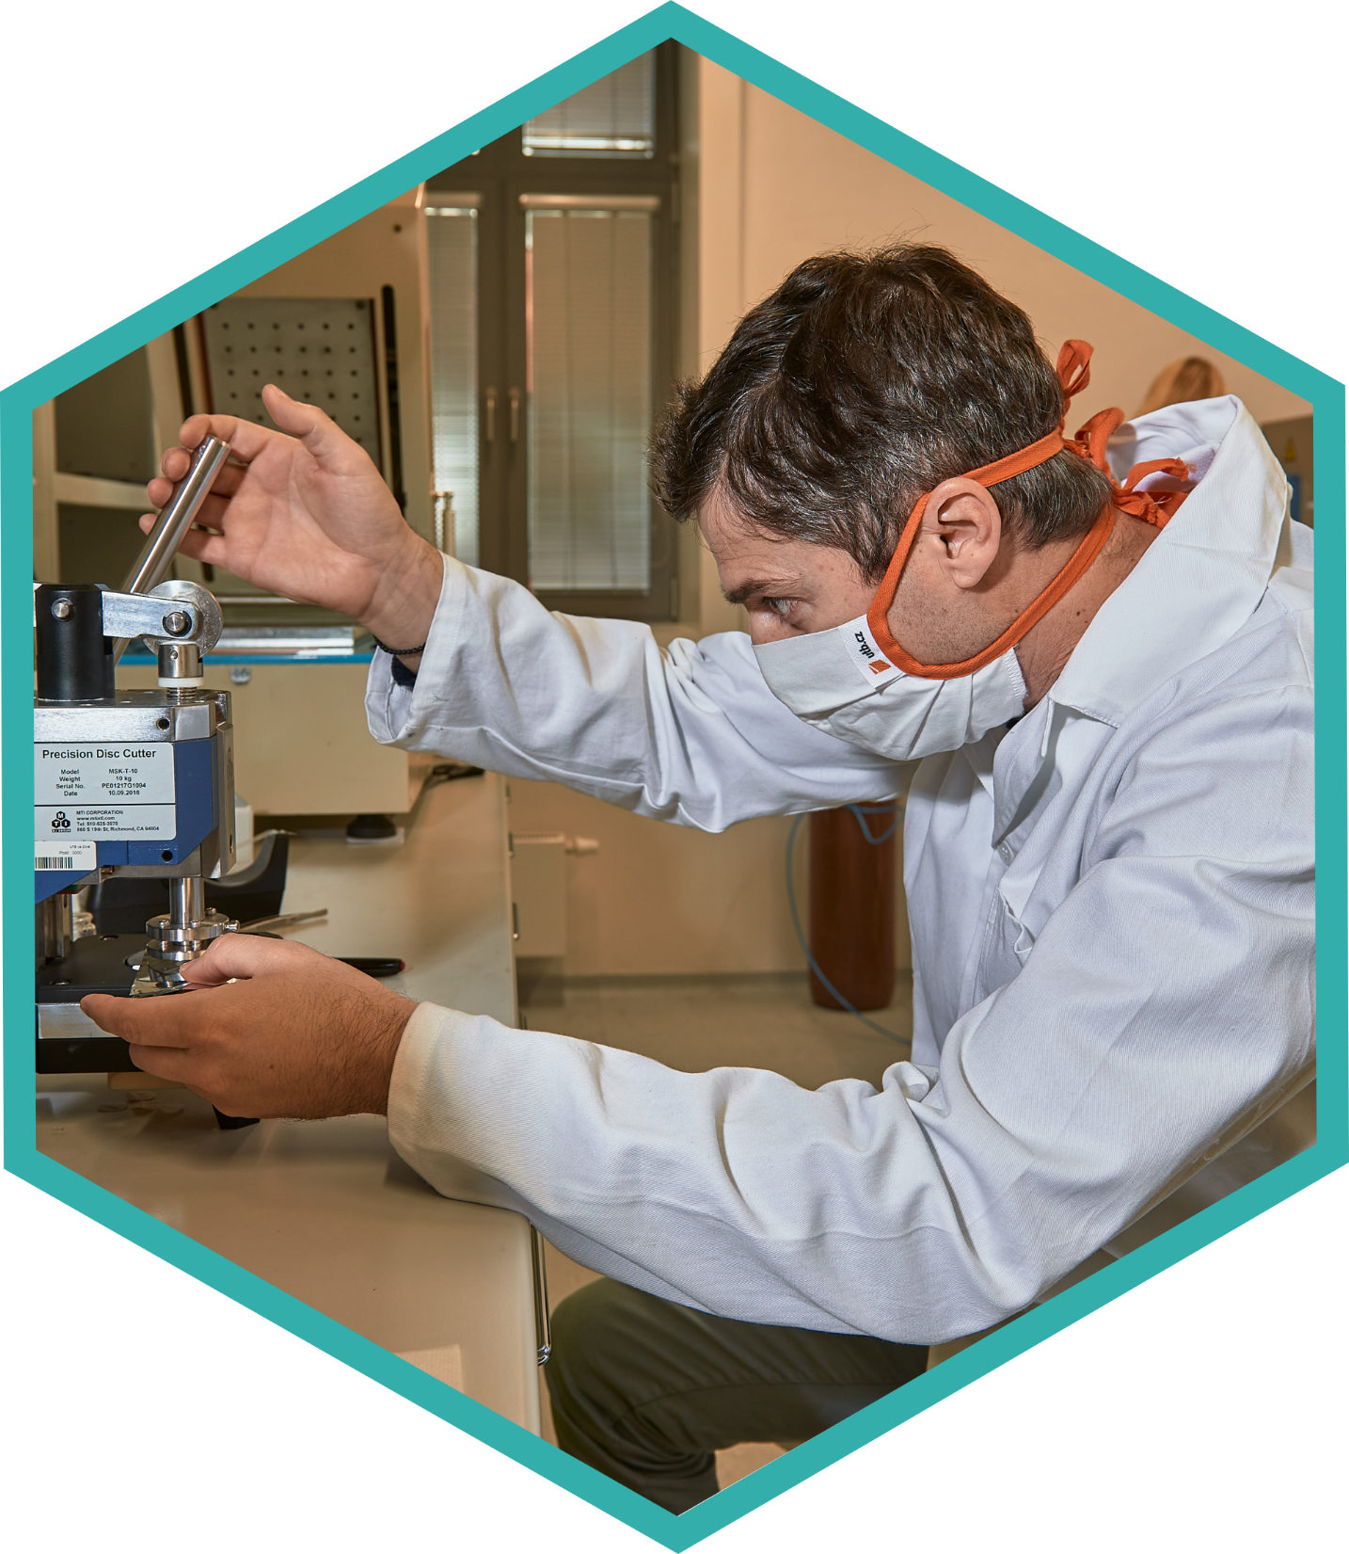
NUMBER OF CPS EMPLOYEES 2017–2020
*Status as of December 7, 2020

Slide 18
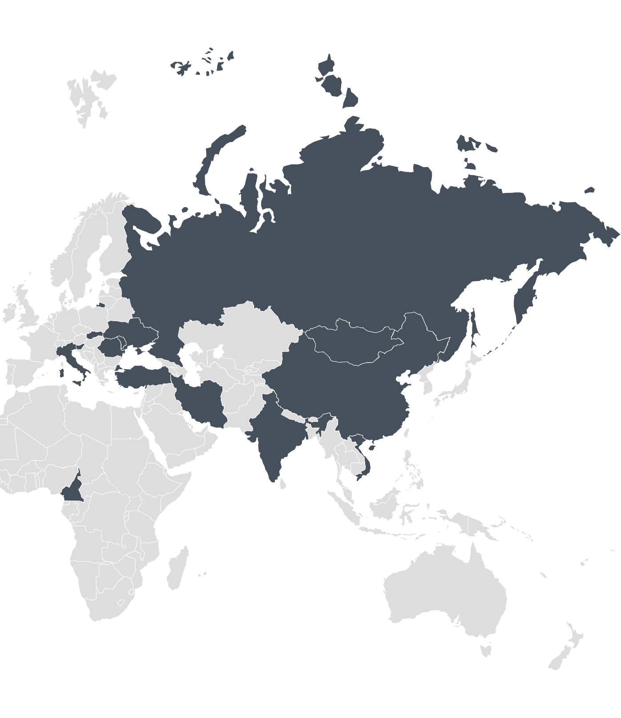
CPS STAFF 2017–2020

Slide 19
CPS STAFF STRUCTURE
RESEARCHERS | 2019 (status as of Dec 31, 2019) |  | 2020 (status as of Dec 7, 2020)
 | NUMBER OF PERSONS | FTE | NUMBER OF PERSONS | FTE
 | 119 | 76.68 | 114 | 77.69
Prof. | 6 | 3.20 | 7 | 4.29
Assoc. Prof. | 16 | 8.40 | 14 | 7.45
Ph.D., Dr. | 67 | 51.23 | 69 | 57.90
Ph.D. students | 30 | 13.85 | 24 | 8.05
ADMINISTRATION, TECHNICIANS | 30 | 19.05 | 28 | 18.29
TOTAL | 149 | 95.73 | 142 | 95.98

Slide 20
CAREER ADVANCEMENT
For the purposes of career advancement, the evaluation and subsequent reevaluation of the results achieved by researchers shall be carried out regularly every three years.
The researcher may request the Director of UNI to re-classify themselves to a higher level of employment.
The relevance of the application for reclassifying a person to a higher level of employment shall be assessed by the Evaluation Committee (the “Committee”), which shall deliver its position to the Director of UNI.

Slide 21
CAREER EVALUATION CRITERIA
 | JIMP Q1/Q2 * (n) | H-index (n) | Projects (PB) **
Job position of Senior researcher – at least 3 years as Junior researcher
Senior researcher | ≥12 | ≥8 | ≥300 4 projects, including 1 case of being a chief project investigator for TBU
Job position of Principal researcher – at least 3 years as Senior researcher
Principal researcher | ≥20 | ≥15 | ≥600 3 cases of being a chief project investigator for TBU
* Senior author (first-listed author / corresponding author) as per records in Web of Science.
** PB as per Rector’s Directive.
In addition, quality parameters – volume of contract research, mobility, internal standards for permanent staff – are taken into account.

Slide 22
MINIMUM CRITERIA FOR CAREER RE-EVALUATION
 | JIMP Q1/Q2 * (n) | Projects (PB) **
Senior researcher | ≥4 | ≥200 1 case of being a chief project investigator for TBU
Principal researcher | ≥6 | ≥400 1 case of being a chief project investigator for TBU
* Senior author (first-listed author / corresponding author) as per records in Web of Science.
** PB as per Rector’s Directive.
In addition, quality parameters – volume of contract research, mobility, internal standards for permanent staff – are taken into account.

Slide 23
FUNDING
Total budget ~113 mil CZK (2020)

Slide 24
TOTAL BUDGET 2018 – 2020

Slide 25
RESEARCH & DEVELOPMENT

Slide 26
EXTERNAL PROJECTS IN 2020
2020
35 PROJECTS
(47 mil. CZK) + 24 mil. CZK*
2018
24 PROJECTS
(63 mil. CZK)
2019
32 PROJECTS
(75 mil. CZK)
* In 2020, after „Centre of polymer systems plus“ project, 6 internal development projects are implemented in CPS. Total amount is about 24 mil. CZK allocated in 2020.

Slide 27
„CENTRE OF POLYMER SYSTEMS PLUS“
LO1504 „Centre of Polymer Systems plus“ project has been implemented at Tomas Bata University in Zlín (TBU) from 2015 to 2020 within the National Programme for Sustainability one (by Ministry of Education, Youth and Sports).
Total amount of funds allocated: 131,8 mil. CZK

Slide 28
EXTERNAL PROJECTS IN 2020
Provider | Grant No.
MINISTRY OF EDUCATION, YOUTH AND SPORTS | LO1504
 | LTAB19019
 | LTAUSA19066
 | LTT20005
 | LTT20010
 | 8JPL19031
 | 8J20PL026
 | 8X20041
 | CZ.02.2.69/0.0/0.0/16_018/0002720
 | CZ.02.2.69/0.0/0.0/16_028/0006243
 | CZ.02.2.69/0.0/0.0/16_027/0008464
 | CZ.02.2.69/0.0/0.0/16_031/0011594
MINISTRY OF INDUSTRY AND TRADE | FV10756
 | FV30048
 | FV30337
 | FV40377
 | CZ.01.1.02/0.0/0.0/17_107/0012417
MINISTRY OF AGRICULTURE | QK1910392
Provider | Grant No.
TECHNOLOGY AGENCY OF THE CZECH REPUBLIC | FW01010327
 | FW01010588
 | FW01010620
 | TH02020836
 | TH03020117
 | TH04020466
 | TH71020005
 | TH71020006
 | TJ02000269
 | TK03030157
 | TP01010006
CZECH SCIENCE FOUNDATION | 19-16861S
 | 19-17457S
 | 19-23513S
 | 19-23647S
 | 20-28732S
Bavarian-Czech Academic Agency | BTHA-AP-2020-DIG-6

Slide 29
INTERNAL GRANT AGENCY PROJECTS IN 2020 (SUPPORTED BY MEYS)
2020
7 PROJECTS
(3,6 mil. CZK)
2018
7 PROJECTS
(4,2 mil. CZK)
2019
10 PROJECTS
(3,3 mil. CZK)

Slide 30
PUBLICATION OUTPUTS IN WOS
Web of Science categories | from 2011 to December 15, 2020

Slide 31
PUBLICATION OUTPUTS IN WOS
Web of Science | from 2011 to December 15, 2020
Document types | Number of documents
Article* | 684
Proceedings paper* | 178
Review | 11
Corrections | 6
Book chapter | 5
Meeting abstract | 4
Editorial material | 3
Letter | 1
Sum of times cited per year
*Some ouputs are both, articles and proceedings papers.

Slide 32
NUMBER OF ARTICLES IN WOS
Articles in Journals with Impact Factor
2017
79
(Q1 - 39%)
2019
92
(Q1 - 57%)
2020
73*
(Q1 - 62%)
2018
86
(Q1 - 37%)
*Status as of December 7, 2020

Slide 33
QUALITY OF PUBLISHED ARTICLES IN 2020
Impact Factor (WoS) vs Article Influence Score (FORD)
*Status as of December 7, 2020

Slide 34
EDUCATION

Slide 35
PHD STUDY PROGRAMMES
Biomaterials and Biocomposites
Nanotechnology and Advanced Materials
*Status as of December 7, 2020

Slide 36
NUMBER OF DOCTORAL STUDENTS IN 2020

Slide 37
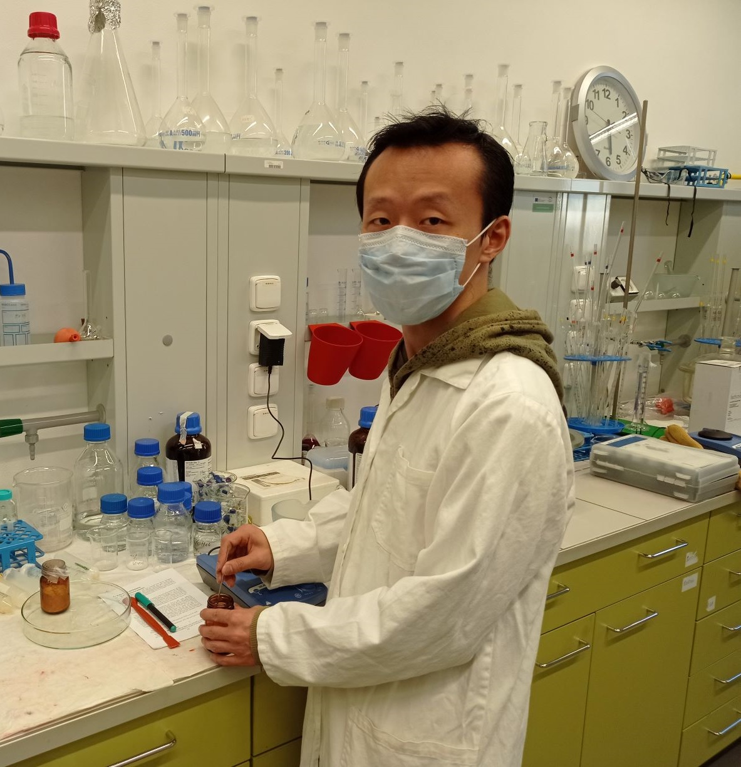
PHD GRADUATES
Dr. Haijun Xiao, the very first graduate of CPS doctoral study programmes.
Study programme Biomaterials and Biocomposites.
Graduated in November 2020.

Slide 38
STUDENTS FROM OTHER FACULTIES IN CPS

Slide 39
CONTRACTED RESEARCH

Slide 40
CONTRACTED RESEARCH
2020
about
8 mil. CZK*
2018
more than
12 mil. CZK
2019
more than
9 mil. CZK
* Estimated amount for 2020.

Slide 41
SELECTED COMMERCIAL PARTNERS
Bata Innovation Lab. (Canada) „Innovation of polymer compounds“
3M (Belgium, USA); SILON s.r.o. (CZ) „Optimization of polymer blends and processing aids“
CONTINENTAL AG (Germany) „Rubber compounds analyses“
JUTA a.s. (CZ) „Optimization of material composition for co-extruded wide-gap profiles“
Pegas Nonwovens s.r.o. (CZ) „Polymer materials analyses and rheological analyses“
Plastics Cluster, Zlín (CZ) – Association of more than 40 companies
Moravian-Silesian Automotive Cluster
Moravian Aerospace Cluster

Slide 42
THIRD ROLE

Slide 43
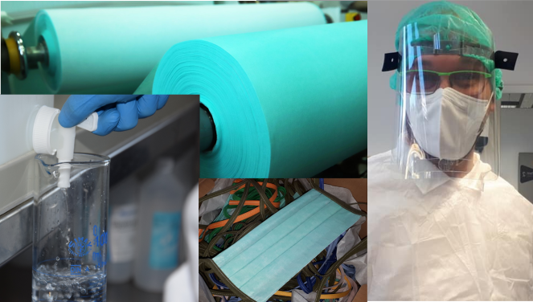
CPS THIRD ROLE
communication with the public
the dissemination of news and results related to CPS research activities in local and national media
participation in fairs and in strategic events such as the Scientist Nights
COVID-19 pandemic

Slide 44
CPS IN 2021

Slide 45
PLANS FOR 2021 – OP RDE PROJECTS
OP RDE PROJECTS IMPLEMENTATION
Developing Research-oriented Degree Programmes at UNI, reg. no. CZ.02.2.69/0.0/0.0/16_018/0002720
Recruiting new students in both study programmes.
The Development of Capacity for Research and Development of TBU in Zlín, reg. no. CZ.02.2.69/0.0/0.0/16_028/0006243
European Commission internal evaluation.
Creation of Lifelong Learning Programs at TBU in Zlín, reg. no. CZ.02.2.69/0.0/0.0/16_031/0011594
Creating of study support resources for Lifelong Learning Programs.
Junior Grants of TBU in Zlín, reg. no. CZ.02.2.69/0.0/0.0/19_073/0016941
Grant competition and start of selected projects implementation.

Slide 46
PLANS FOR 2021 – R&D PROJECTS
R&D PROJECTS
Further implementation of running external projects.
Further implementation of internal development projects.
Submitting new project proposals in the national and international calls.
Submitting new IGA projects .

Slide 47
THANK YOU FOR
YOUR ATTENTION
Vladimír Sedlařík
sedlarik@utb.cz

